Slide 1

BRUTE FORCE

Slide 2
Brute Force
Definition: Brute force is a straightforward approach to problem-solving that relies on directly applying the problem statement and definitions of the concepts involved.
"Just do it!": The strategy's essence is to utilize the computational power of a computer rather than relying on complex intellectual reasoning.
Simplicity: Brute force often represents the easiest and most intuitive method to apply when solving a problem.
Example: The exponentiation problem, where you need to compute a^b for a given number a and non-negative integer b, can be solved using brute force.
Algorithm Design: Brute force serves as a useful illustration of various algorithm design techniques.

Slide 3
Selection Sort and Bubble Sort
The brute-force approach can also be applied to the problem of sorting, which involves rearranging a list of n orderable items in nondecreasing order.
Importance of Sorting: Sorting is a fundamental problem in computer science, and numerous algorithms have been developed to solve it efficiently.
Fresh Perspective: The suggestion is to temporarily forget any previous knowledge of sorting algorithms and approach the problem with a fresh mind.
Straightforward Method: When considering the most straightforward method for solving the sorting problem, reasonable people may have different opinions.
Prime Candidates: Two algorithms that are often considered as prime candidates for the most straightforward method are selection sort and bubble sort.
Selection Sort: Among the two algorithms, selection sort is generally considered to be better overall and implements the brute-force approach more clearly.

Slide 4
Selection Sort
Procedure
Scan the array to find its smallest element and swap it with the first element. Then, starting with the second element, scan the elements to the right of it to find the smallest among them and swap it with the second elements. Generally, on pass i (0 ≤ i ≤ n-2), find the smallest element in A[i..n-1] and swap it with A[i]:
A[0] ≤ . . . ≤ A[i-1] | A[i], . . . , A[min], . . ., A[n-1]
Notes:
We start selection sort by scanning the entire given list to find its smallest element and exchange it with the first element, putting the smallest element in its final position in the sorted list. Then we scan the list, starting with the second element, to find the smallest among the last n - 1 elements and exchange it with the second element, putting the second smallest element in its final position.

Slide 5
Selection Sort
Procedure
Scan the array to find its smallest element and swap it with the first element. Then, starting with the second element, scan the elements to the right of it to find the smallest among them and swap it with the second elements. Generally, on pass i (0 ≤ i ≤ n-2), find the smallest element in A[i..n-1] and swap it with A[i]:
A[0] ≤ . . . ≤ A[i-1] | A[i], . . . , A[min], . . ., A[n-1]
Notes:
Generally, on the ith pass through the list, which we number from 0 ton - 2, the algorithm searches for the smallest item among the last n - i elements and swaps it with A; After n - 1 passes, the list is sorted.

Slide 6
Selection Sort Algorithm
ALGORITHM Selection Sort(A[0 .. n-1])
// Sorts a given array using selection sort
// Input: An array A[0 .. n-1] of orderable elements
// Output: Array A[0 .. n-1] sorted in ascending order
for i <- 0 to n-2 do
Notes:
Outer Loop:
The outer loop iterates from i = 0 to n-2. The loop variable i represents the current position where the minimum element for the current pass will be placed.

Slide 7
Selection Sort Algorithm
ALGORITHM Selection Sort(A[0 .. n-1])
// Sorts a given array using selection sort
// Input: An array A[0 .. n-1] of orderable elements
// Output: Array A[0 .. n-1] sorted in ascending order
for i <- 0 to n-2 do
min <- i
Notes:
Initialize min:
At the beginning of each iteration of the outer loop, min is initialized to the current value of i. This variable keeps track of the index of the minimum element found in the inner loop.

Slide 8
Selection Sort Algorithm
ALGORITHM Selection Sort(A[0 .. n-1])
// Sorts a given array using selection sort
// Input: An array A[0 .. n-1] of orderable elements
// Output: Array A[0 .. n-1] sorted in ascending order
for i <- 0 to n-2 do
min <- i
for j <- i+1 to n-1 do
Notes:
Inner Loop:
The inner loop starts from j = i+1 and goes up to n-1. It is used to find the index of the minimum element in the remaining unsorted portion of the array. Inner loop for finding the minimum element in the unsorted part

Slide 9
Selection Sort Algorithm
ALGORITHM Selection Sort(A[0 .. n-1])
// Sorts a given array using selection sort
// Input: An array A[0 .. n-1] of orderable elements
// Output: Array A[0 .. n-1] sorted in ascending order
for i <- 0 to n-2 do
min <- i
for j <- i+1 to n-1 do
if A[j] < A[min]
Notes:
Find Minimum:
In the inner loop, there's a conditional statement if A[j] < A[min]. If the element at index j is smaller than the element at index min, update the value of min to j.

Slide 10
Selection Sort Algorithm
ALGORITHM Selection Sort(A[0 .. n-1])
// Sorts a given array using selection sort
// Input: An array A[0 .. n-1] of orderable elements
// Output: Array A[0 .. n-1] sorted in ascending order
for i <- 0 to n-2 do
min <- i
for j <- i+1 to n-1 do
if A[j] < A[min]
min <- j

Slide 11
Selection Sort Algorithm
ALGORITHM Selection Sort(A[0 .. n-1])
// Sorts a given array using selection sort
// Input: An array A[0 .. n-1] of orderable elements
// Output: Array A[0 .. n-1] sorted in ascending order
for i <- 0 to n-2 do
min <- i
for j <- i+1 to n-1 do
if A[j] < A[min]
min <- j
swap A[i] and A[min]
Notes:
Swap:
After the inner loop completes, it means we have found the index of the smallest element in the unsorted portion. We then swap the element at index i with the element at index min. This effectively moves the smallest element to its correct sorted position in the array.

Slide 12
Selection Sort Algorithm
ALGORITHM Selection Sort(A[0 .. n-1])
// Sorts a given array using selection sort
// Input: An array A[0 .. n-1] of orderable elements
// Output: Array A[0 .. n-1] sorted in ascending order
for i <- 0 to n-2 do
min <- i
for j <- i+1 to n-1 do
if A[j] < A[min]
min <- j
swap A[i] and A[min]
Notes:
Repeat:
The outer loop continues this process for each position in the array until the entire array is sorted.

Slide 13
Example:{3,1,2}…Ist iteration
i=0
Min=i
j=i+1=0+1=1
A[1]<A[0]
1<3 (True)
Min=j
Min=1
Swap(a[i] and a[min])=swap(a[0] and a[1])=[1,3,2]

Slide 14
IInd iteration
i=1
Min=i
j=i+1=1+1=2
A[2]<A[1]
2<3 (True)
Min=j
Min=2
Swap(a[i] and a[min])=swap(a[1] and a[2])=[1,2,3]

Slide 15
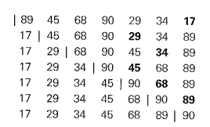


Selection Sort Analysis with example
Notes:
After substituting thr value….(n-1)+(n-2)+(n-3)+------1=(n-1)(n)/2=o(n^2)

Slide 16
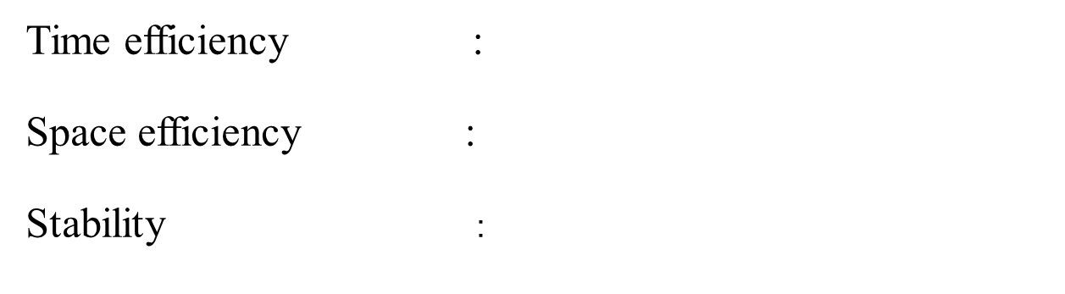
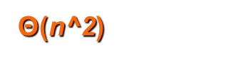
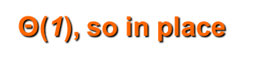

Time and Space Complexity
Notes:
Selection sort is an in-place algorithm. It performs all computation in the original array and no other array is used. Hence, the space complexity works out to be O(1).

Slide 17
Bubble Sort
Another brute-force application to the sorting problem is to compare of the list and exchange them if they are out of order. By doing it repeatedly, we end up “bubbling up” the largest element to the last position on the list. The next pass bubbles up the second largest element, and so on, until after n−1 passes the list is sorted. Pass i(0≤i≤n−2)of bubble sort.
A0,...,Aj↔Aj+1,...,An−i−1|An−i≤...≤An−1

Slide 18

Bubble Sort Algorithm
//Sorts a given array by bubble sort in their final positions
//Input: An array A[0 .. n- 1] of orderable elements
//Output: Array A[0 .. n- 1] sorted in ascending order
BubbleSort(A[0 .. n - 1])
for i <-- 0 to n - 2 do
for j <-- 0 to n - 2 - i do
if A[j + 1] < A[j] then
swap A[j] and A[j + 1]
Notes:
for i <-- 0 to n - 2 do:
The outer loop iterates over the array from the first element (index 0) to the second-to-last element (index n - 2). This is because, in each pass through the outer loop, the largest unsorted element "bubbles up" to its correct position at the end of the array. After each pass, the largest element is guaranteed to be in its final sorted position, so there is no need to include it in subsequent iterations.

Slide 19
Bubble Sort Algorithm
//Sorts a given array by bubble sort in their final positions
//Input: An array A[0 .. n- 1] of orderable elements
//Output: Array A[0 .. n- 1] sorted in ascending order
BubbleSort(A[0 .. n - 1])
for i <-- 0 to n - 2 do
for j <-- 0 to n - 2 - i do
if A[j + 1] < A[j] then
swap A[j] and A[j + 1]
Notes:
for j <-- 0 to n - 2 - i do:
The inner loop iterates over the unsorted part of the array. The condition n - 2 - i represents the range of elements that still need to be considered in the inner loop. As the outer loop progresses, the largest unsorted element is moved to its correct position, so there is no need to include it in the inner loop comparisons. This avoids unnecessary comparisons for elements that are already in their correct positions.

Slide 20

Working of Bubble sort Algorithm
Let the elements of array are -

Slide 21
First pass
13 ,32,26,35,10
13 ,32,26,35,10
13 ,26,32,35,10
13 ,26,32,35,10
13 ,26,32,10,35

Slide 22
Second pass
13 ,26,32,10,35
13 ,26,32,10,35
13 ,26,32,10,35
13 ,26,10,32,35
13 ,26,10,32,35

Slide 23
Third pass
13 ,26,10,32,35
13 ,26,10,32,35
13 ,10,26,32,35
13 ,10,26,32,35
13 ,10,26,32,35

Slide 24

Fourth pass
Similarly, after the fourth iteration, the array will be –

Slide 25
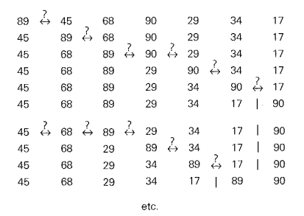
Bubble Sort Example

Slide 26
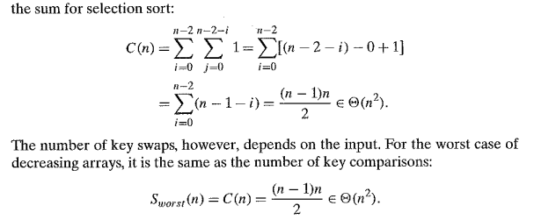
Bubble Sort Analysis
Notes:
Best Case Complexity - It occurs when there is no sorting required, i.e. the array is already sorted. The best-case time complexity of bubble sort is O(n).

Slide 27
Sequential or Linear Search
Int SequentialSearch(int a[], int n, const int& x) a[0] a[1] ….a[n-1]
{
int i;
for (i = 0; i < n && a[i] != x; i++);
if (i == n) return -1;
else return i;
}
Notes:
The time complexity of the provided SequentialSearch function is O(n), where 'n' is the number of elements in the array. Let's break down the analysis:

Slide 28
Sequential or Linear Search
Int SequentialSearch(int a[], int n, const int& x) a[0] a[1] ….a[n-1]
{
int i;
for (i = 0; i < n && a[i] != x; i++);
if (i == n) return -1;
else return i;
}
Notes:
The function uses a for loop that iterates through each element of the array (for (i = 0; i < n && a[i] != x; i++)).

Slide 29
Sequential or Linear Search
Int SequentialSearch(int a[], int n, const int& x) a[0] a[1] ….a[n-1]
{
int i;
for (i = 0; i < n && a[i] != x; i++);
if (i == n) return -1;
else return i;
}
Notes:
The loop condition i < n && a[i] != x ensures that the loop will terminate either when the element is found (a[i] == x) or when the end of the array is reached (i == n).

Slide 30
Sequential or Linear Search
Int SequentialSearch(int a[], int n, const int& x) a[0] a[1] ….a[n-1]
{
int i;
for (i = 0; i < n && a[i] != x; i++);
if (i == n) return -1;
else return i;
}
Notes:
In the worst case, the loop will iterate through all 'n' elements of the array before finding the element or reaching the end.

Slide 31
Sequential or Linear Search
Int SequentialSearch(int a[], int n, const int& x) a[0] a[1] ….a[n-1]
{
int i;
for (i = 0; i < n && a[i] != x; i++);
if (i == n) return -1;
else return i;
}
Notes:
Therefore, the maximum number of iterations is directly proportional to the number of elements in the array, leading to a linear time complexity of O(n).

Slide 32
Sequential Search
//Implements sequential search with a search key as a sentinel
//Input: An array A of n elements and a search key K
//Output: The index of the first element in A[O .. n -1) whose value is II equal to K or -1 if no such element is found
SequentialSearch(A[0..n], K)
A[n] <- K
i <- 0
while A[i] != K do
i <- i + 1
if i < n then
return i
else
return –1
Time Complexity ---- ???

Slide 33
String Matching
The string-matching problem involves finding a substring in a given text that matches a given pattern.
Example : Nobody noticed him
Notes:
Given a string of n characters called the text and a string of m characters (m <= n) called the pattern, find a substring of the text that matches the pattern.

Slide 34
String Matching
The goal is to find the index i of the leftmost character of the first matching substring in the text.
The algorithm starts by comparing the first character of the pattern with the characters in the text starting from the first character.
If there is a match, it continues to compare the next characters of the pattern with the consecutive characters in the text.
If there is a mismatch at any point, the algorithm moves to the next character in the text and starts comparing again from there.
In our example, the algorithm would compare "not" with the first three characters of the text - "Nob". It would find a mismatch and move to the next character.
The algorithm continues this process until either a complete match is found or the end of the text is reached.
If a match is found, the algorithm returns the index i of the leftmost character of the matching substring.

Slide 35
String Matching
The string-matching problem involves finding a substring in a given text that matches a given pattern.
Example : Nobody noticed him
In this example, the text is "Nobody noticed him" and the pattern is not specified. We'll assume the pattern is "not" for demonstration purposes.

Slide 36
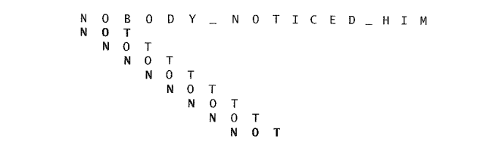
String Matching
Notes:
1.Start comparing the pattern "N 0 T" with the text from the beginning.
2. At the first position, "N" matches with the first character of the text, "0" matches the second, but "T" doesn't match "B.“
3. Since there's a mismatch, shift the pattern one position to the right: "0 T" is now aligned with "0 D" in the text.
4. Continue comparing until the end of the text or until a match is found.

Slide 37
String Matching Algo
ALGORITHM Brute Force String Match(T[0..n−1],P[0..m−1])
//Implements brute-force string matching
//Input: An array T[0..n−1] of n characters representing a text and
//an array P[0..m−1] of m characters representing a pattern
//Output: The index of the first character in the text that starts a
//matching substring or−1 if the search is unsuccessful for
for i←0 to n−m do
j←0
While j<m and P[j]=T[i+j]do
j←j+1
if j=m return i
return−1
Notes:
Outer Loop (for i ← 0 to n − m):
Iterates through every potential starting position in the text T where the pattern P might begin.
The loop runs until n − m, ensuring there’s enough room in T for the pattern P to match.
Inner Loop (while j < m and P[j] = T[i + j]):
Compares each character in the pattern P with the corresponding character in the text T starting at index i.
Continues as long as the characters match (P[j] = T[i + j]) and the index j is within the length of the pattern (j < m).
Successful Match (if j = m):
If all characters of P match (j reaches m), the starting index i is returned as the result.
Unsuccessful Match (return −1):
If no match is found after all iterations, the function returns −1.

Slide 38
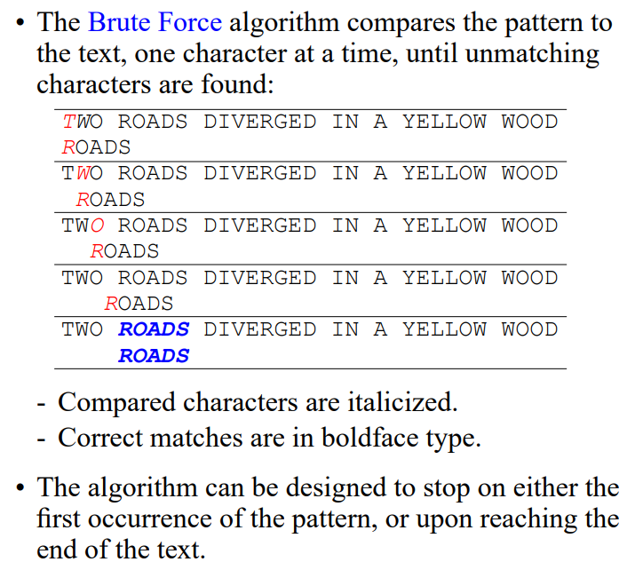

Slide 39
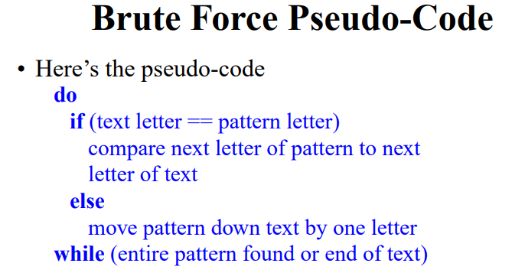

Slide 40
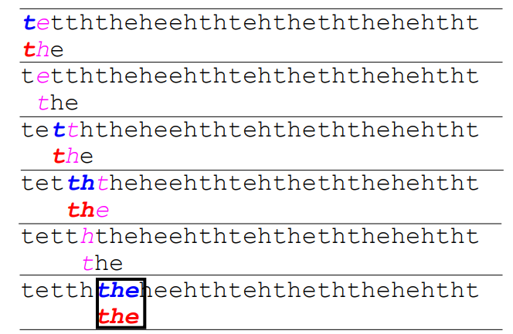

Slide 41
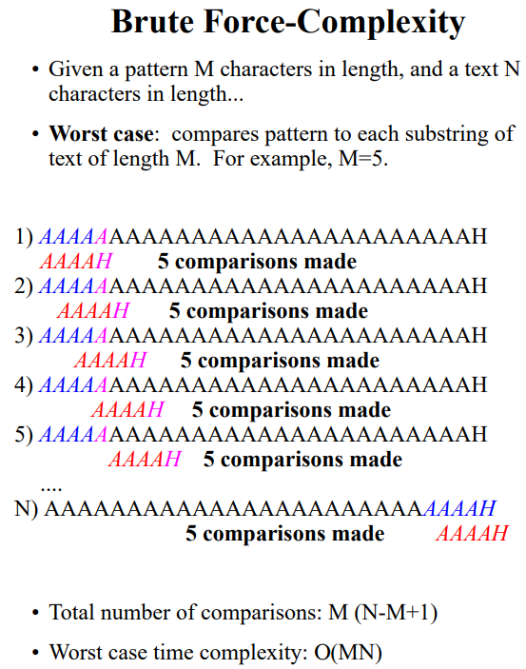

Slide 42
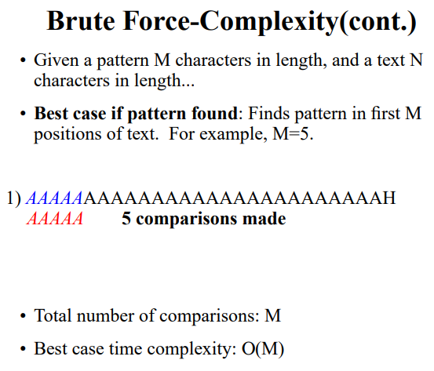

Slide 43
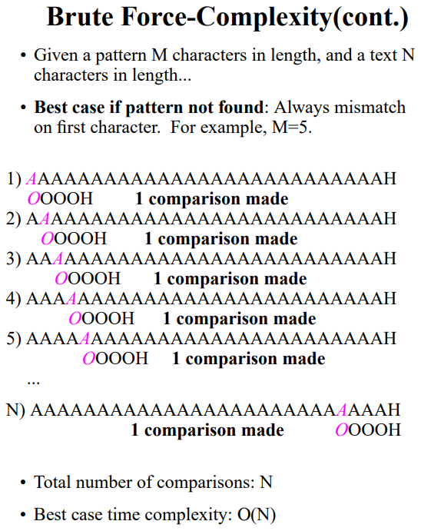

Slide 44
String Matching Time Complexity
In the worst case scenario, the algorithm may have to make all m comparisons before shifting the pattern.
This worst case can happen for each of the n - m + 1 tries, where n is the length of the text and m is the length of the pattern.
So, in the worst case, the time complexity of the algorithm is O(n * m), which means it grows proportionally to the product of the lengths of the text and the pattern.
However, for a typical word search in a natural language text, most shifts happen after very few comparisons.
This means that in practice, the average-case efficiency of the algorithm is considerably better than the worst-case efficiency.
In fact, for searching in random texts, it has been shown that the average-case time complexity is linear, meaning it grows linearly with the sum of the lengths of the text and the pattern. So it is O(n + m).
This linear time complexity, O(n + m), is much more efficient than the worst-case time complexity, O(n * m).
It's important to note that these time complexities are specific to the algorithm being used. Different string-matching algorithms may have different time complexities and performance characteristics.

Slide 45
Exhaustive search
Exhaustive search is a method in which solution is obtained by searching each element of given problem. Exhaustive search makes use of straight forward approach.
Travelling salesman problem
Knapsack problem
Assignment problem
Notes:
Exhaustive search is a very general problem-solving technique and algorithmic paradigm that consists of systematically checking all possible candidates for whether or not each candidate satisfies the problem's statement.
Exhaustive search is simply a brute-force approach to combinatorial problems. It suggests generating each and every element of the problem's domain, selecting those of them that satisfy all the constraints, and then finding a desired element (e.g., the one that optimizes some objective function).

Slide 46
Exhaustive search
Exhaustive search is a method in which solution is obtained by searching each element of given problem. Exhaustive search makes use of straight forward approach.
Travelling salesman problem
Knapsack problem
Assignment problem
Notes:
Many important problems require finding an element with a special property in a domain that grows exponentially (faster) with an instance size. Typically, such problems arise in situations that involve "combinatorial" objects such as permutations, combinations, and subsets of a given set. Many such problems are optimization problems (max or min).

Slide 47
Exhaustive search
Exhaustive search is a method in which solution is obtained by searching each element of given problem. Exhaustive search makes use of straight forward approach.
Travelling salesman problem
Knapsack problem
Assignment problem
Notes:
The exhaustive search is a brute-force approach to combinatorial problems. It suggests generating each and every element of the problem's domain, selecting those of them that satisfy the problem's constraints, and then finding a desired element.

Slide 48

Traveling Salesman Problem (TSP)
The TSP involves finding the shortest possible route that a salesman can take to visit a set of cities and return to the starting city, while visiting each city exactly once.
The cities and their connections are represented as a weighted graph, where the weights along the edges represent the distances or costs between the cities. The goal is to find the route with the minimum total weight.

Slide 49
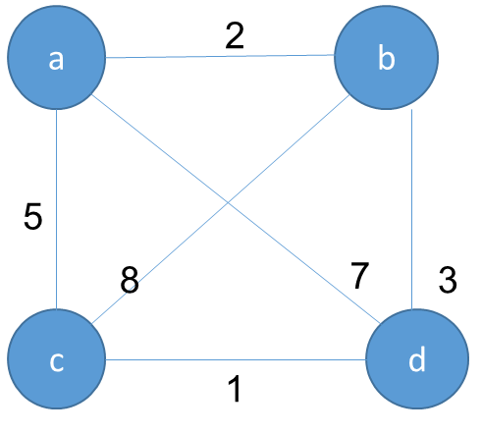
TSP PROBLEM
Notes:
The problem can be conveniently modeled by a weighted graph, with the graph's vertices representing the cities and the edge weights specifying the distances. Then the problem can be stated as the problem of finding the shortest Hamiltonian circuit of the graph. (A Hamiltonian circuit is defined as a cycle that passes through all the vertices of the graph exactly once.

Slide 50
TSP PROBLEM
Notes:
The problem asks to find the shortest tour through a given set of (n) cities that visits each city exactly once before returning to the city where it started.

Slide 51
TSP - SOLUTION
Tour | Length | Solution
a-b-c-d-a | 2+8+1+7=18
a-b-d-c-a | 2+3+1+5=11 | Optimal solution
a-c-b-d-a | 5+8+3+7=23
a-c-d-b-a | 5+1+3+2=11 | Optimal solution
a-d-b-c-a | 7+3+8+5=23
a-d-c-b-a | 7+1+8+2=18
Notes:
The total number of permutations is still (n-1)! , which makes the exhaustive search approach impractical for all but very small values of n. This is because one city is typically fixed as the starting point, and the remaining (n-1) cities are permuted. Therefore, the time complexity can also be expressed as O((n-1)!).

Slide 52

TSP - SOLUTION
Tour | Length | Solution
a-b-c-d-a | 2+8+1+7=18
a-b-d-c-a | 2+3+1+5=11 | Optimal solution
a-c-b-d-a | 5+8+3+7=23
a-c-d-b-a | 5+1+3+2=11 | Optimal solution
a-d-b-c-a | 7+3+8+5=23
a-d-c-b-a | 7+1+8+2=18

Slide 53
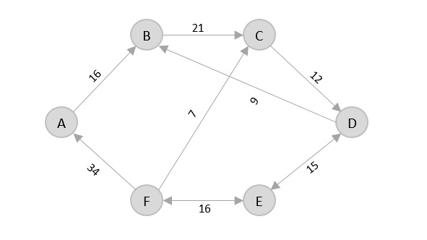
Solve using TSP?

Slide 54
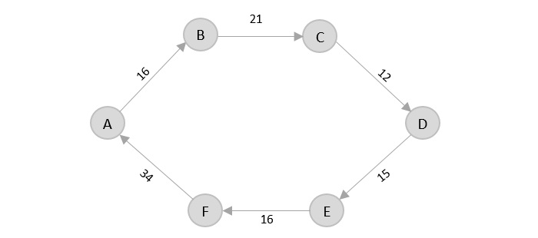
Notes:
The shortest path that originates and ends at A is A → B → C → D → E → F → A
The cost of the path is: 16 + 21 + 12 + 15 + 16 + 34 = 114.

Slide 55
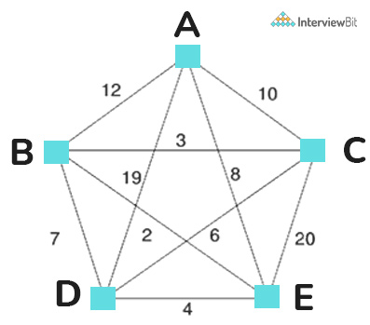
SOLVE USING TSP?

Slide 56
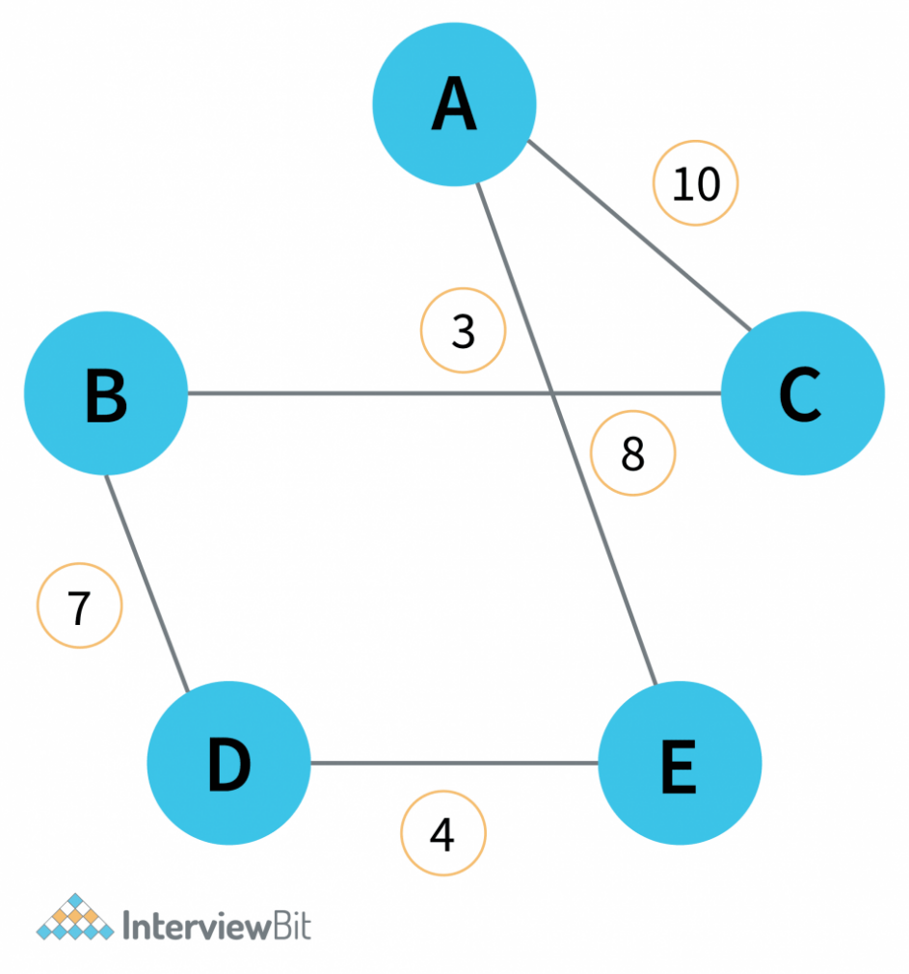
SOLUTION
Notes:
Minimum weight Hamiltonian Cycle: EACBDE= 32

Slide 57
KNAPSACK PROBLEM
The Knapsack Problem involves selecting a subset of items from a given set, where each item has a weight and a benefit value. The goal is to maximize the total benefit value of the selected items while ensuring that the total weight does not exceed the knapsack's maximum capacity.
The problem can be formulated as an optimization problem, where the decision variables represent whether an item is included in the knapsack or not. Different algorithms, such as dynamic programming or greedy algorithms, can be used to solve the Knapsack Problem and find the optimal solution.

Slide 58
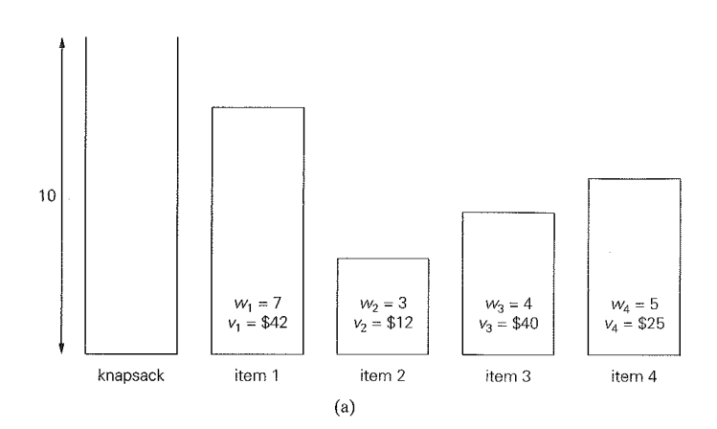

Slide 59
Subset | Total weight | Total value
Φ | 0 | $0
{1} | 7 | $42
{2} | 3 | $12
{3} | 4 | $40
{4} | 5 | $25
{1, 2} | 10 | $54
{1, 3} | 11 | not feasible
{1, 4} | 12 | not feasible
{2, 3} | 7 | $52
{2, 4} | 8 | $37
{3, 4} | 9 | $65 (Maximum-Optimum)
{1, 2, 3} | 14 | not feasible
{1, 2, 4} | 15 | not feasible
{1, 3, 4} | 16 | not feasible
{ 2, 3, 4} | 12 | not feasible
{1, 2, 3, 4} | 19 | not feasible

Slide 60
KNAPSACK PROBLEM
Item i | Weight W_{i} | Value V_{i}
1 | 2 | $1
2 | 3 | $2
3 | 4 | $8
4 | 5 | $6

Slide 61

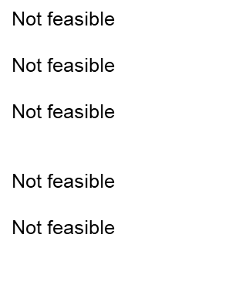
KNAPSACK SOLUTION
Item i | Weight W_{i} | Value V_{i}
Item 1 | ∑w_{i}=2 | ∑V_{i}=$1
Item 2 | ∑w_{i}=3 | ∑V_{i}=$2
Item 3 | ∑w_{i}=4 | ∑V_{i}=$8
Item 4 | ∑w_{i}=5 | ∑V_{i}=$6
Item 1,2 | ∑w_{i}=2+3=5 | ∑V_{i}=1+2=$3
Item 1,3 | ∑w_{i}=2+4=6 | ∑V_{i}=1+8=$9
Item 1,4 | ∑w_{i}=2+5=7 | ∑V_{i}=1+6=$7
Item 2,3 | ∑w_{i}=3+4=7 | ∑V_{i}=2+8=$10
Item 2,4 | ∑w_{i}=3+5=8 | ∑V_{i}=2+6=$8
Item 3,4 | ∑w_{i}=4+5=9 | ∑V_{i}=8+6=$14
Item 1,2,3 | ∑w_{i}=2+3+4=9 | ∑V_{i}=1+2+8=$11
Item 1,2,4 | ∑w_{i}=2+3+5=10 | ∑V_{i}=1+2+6=$9
Item 2,3,4 | ∑w_{i}=3+4+5=12 | ∑V_{i}=2+8+6=$16
Item 1,2,3,4 | ∑w_{i}=2+3+4+5=14 | ∑V_{i}=1+2+8+6=$17
Notes:
Here item 1,3,4 and none…also there..so 2^4=16 possible sets

Slide 62
The number of subsets of an n-element set is 2^n.
This is because, for each element in the set, you have two choices: include it in a subset or exclude it. Therefore, the total number of possible subsets is 2^n.
Notes:
The exhaustive search algorithm for subset problems involves considering all possible subsets to find the optimal solution based on certain criteria (e.g., maximizing or minimizing a value while staying within a constraint.)

Slide 63
The number of subsets of an n-element set is 2^n.
This is because, for each element in the set, you have two choices: include it in a subset or exclude it. Therefore, the total number of possible subsets is 2^n.
Notes:
Exponential Time Complexity: Due to the 2^n nature of the search space, the time complexity of the exhaustive search algorithm is exponential. Even if individual subsets are generated efficiently, the sheer number of subsets to consider makes the overall algorithm inefficient.

Slide 64
The number of subsets of an n-element set is 2^n.
This is because, for each element in the set, you have two choices: include it in a subset or exclude it. Therefore, the total number of possible subsets is 2^n.
Notes:
Algorithmic Complexity: The statement refers to the algorithm having a time complexity of O(2^n). This is a very high complexity, and as n grows, the number of subsets and the time required for the exhaustive search grows exponentially.

Slide 65

Assignment Problem
The Assignment Problem involves assigning n people to n jobs, with the goal of minimizing the total cost associated with the assignments. Each person can be assigned to only one job, and each job can be assigned to only one person.
The cost of assigning a particular person to a particular job is represented by the cost matrix C[i, j]. The objective is to find the assignment that results in the minimum total cost across all assignments.
Notes:
The problem is to find an assignment with the smallest total cost.

Slide 66
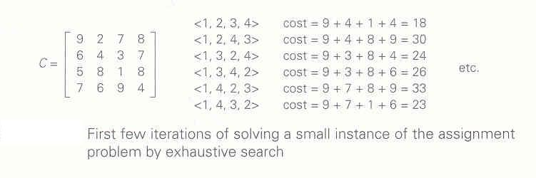

Slide 67
Assignment Problem
 | Job 1 | job2 | Job 3 | job4
Person 1 | 10 | 3 | 8 | 9
Person 2 | 7 | 5 | 4 | 8
Person 3 | 6 | 9 | 2 | 9
Person 4 | 8 | 7 | 10 | 5
Notes:
The problem calls for a selection of one element in each row of the matrix so that all selected elements are in different columns and the total sum of the selected elements is the smallest possible.

Slide 68
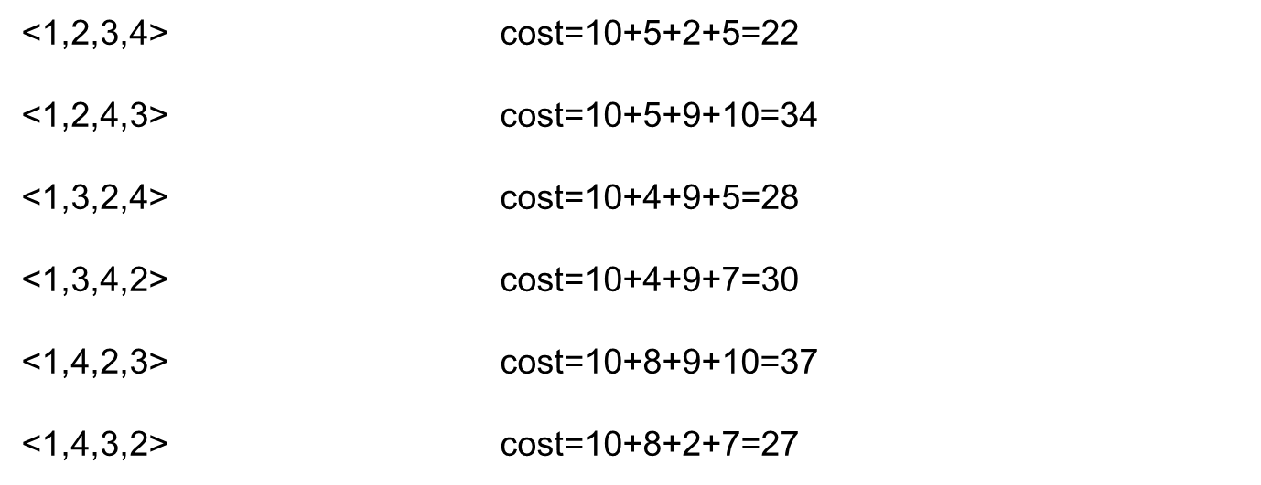
Assignment Problem- Solution

Slide 69
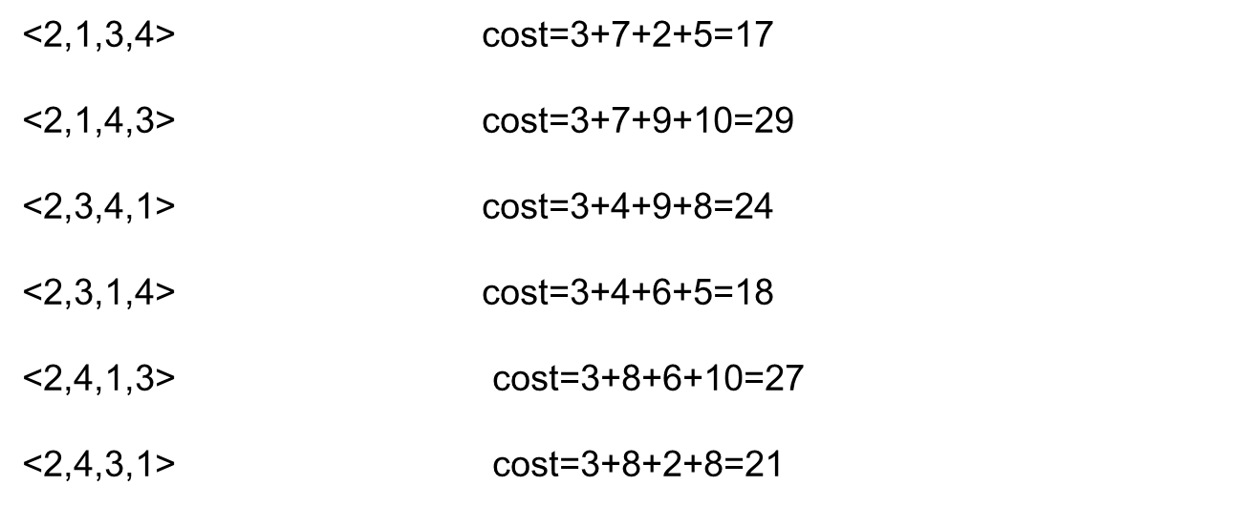
Assignment Problem- Solution

Slide 70
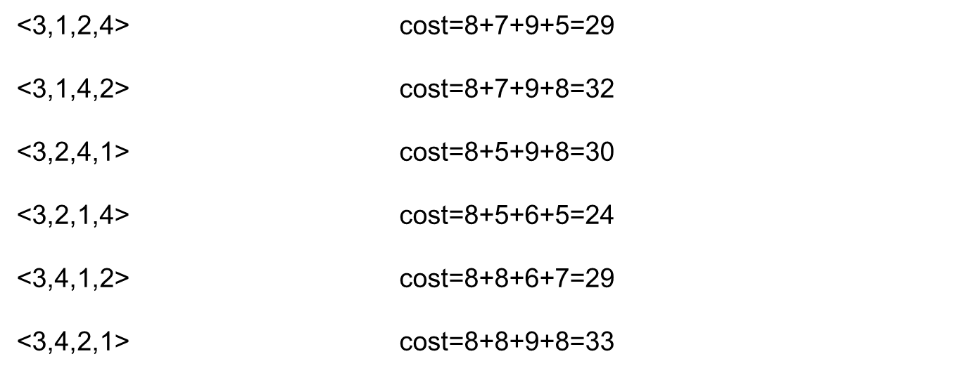
Assignment Problem- Solution

Slide 71
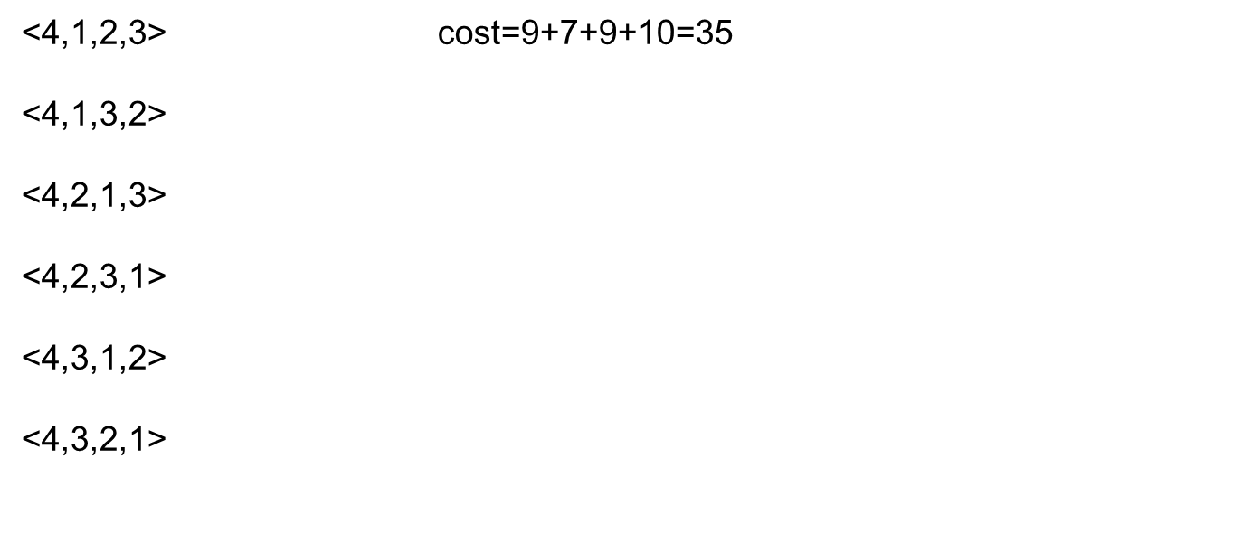
Assignment Problem- Solution
Notes:
The simplest algorithm is a direct exhaustive search (brute force algorithm), which is very simple algorithm.
Exhaustive search algorithms are usually not as efficient as possible.

Slide 72
Assignment Problem-Analysis
Thus by trying 24 permutation(n!=4!=24),we can obtain feasible solution.the feasible solution is <2,1,3,4>i.e.cost=3+7+2+5=17.
Thus we have to generate n! instances to find solution using exhaustive search. This also shows how inefficient exhaustive search method is for solving such problems.
For solving these types of problems, many efficient algorithms are available

Slide 73

Breadth First Search (BFS)
• BFS is a graph traversal/search algorithm that begins at the root node and explores all the neighboring nodes.
•Then for each of those nearest nodes, the algorithm explores their unexplored neighbor nodes, and so on, until it finds the goal.
•This technique is used for searching a vertex in a graph.
•It produces a spanning tree as a final result if graph is connected.
••Here we use Queue data structure with maximum size of total number of vertices in the graph.

Slide 74
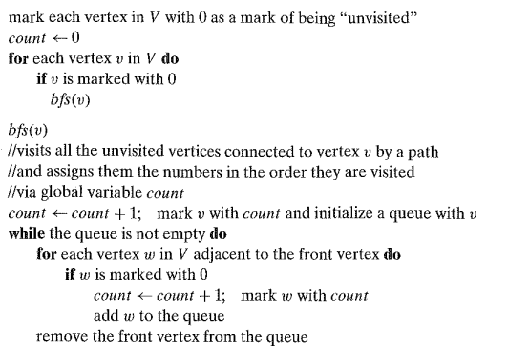
Algorithm BFS
ALGORITHM BFS(G) //Implements a breadth-first search traversal of a given graph
//Input: Graph G = (V, E)
//Output: Graph G with its vertices marked with consecutive integers
//in the order they have been visited by the BFS traversal

Slide 75
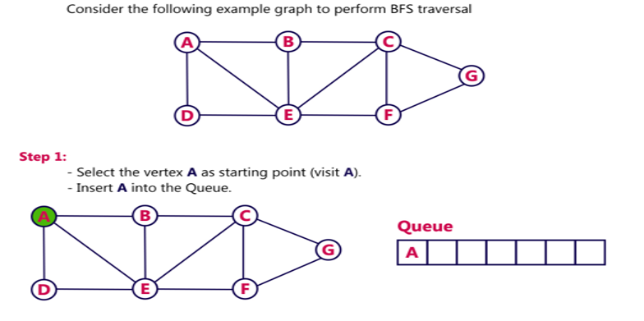
BFS

Slide 76
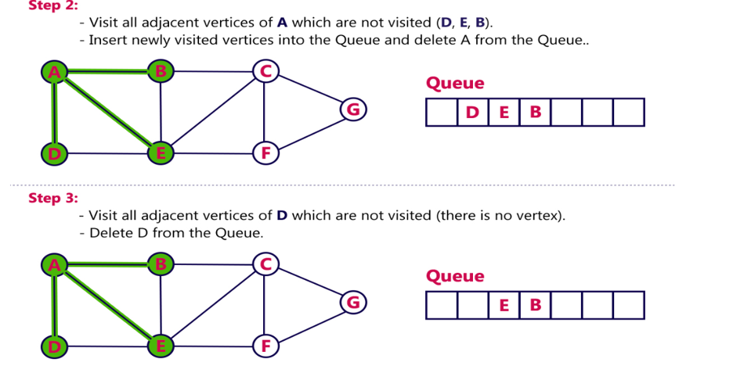
BFS

Slide 77
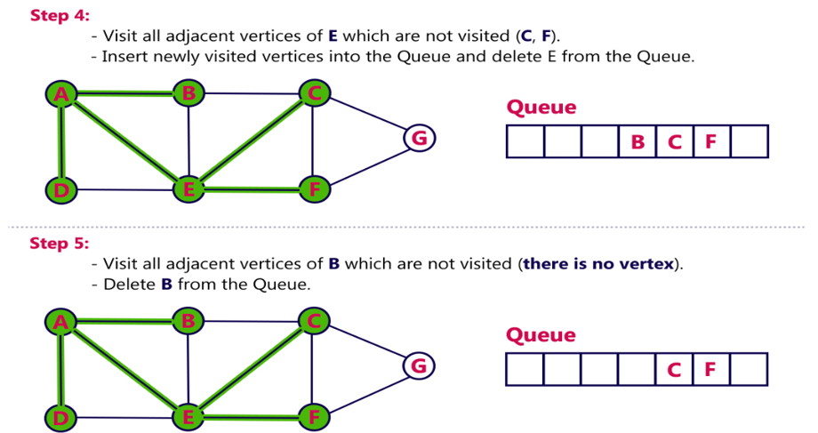
BFS

Slide 78
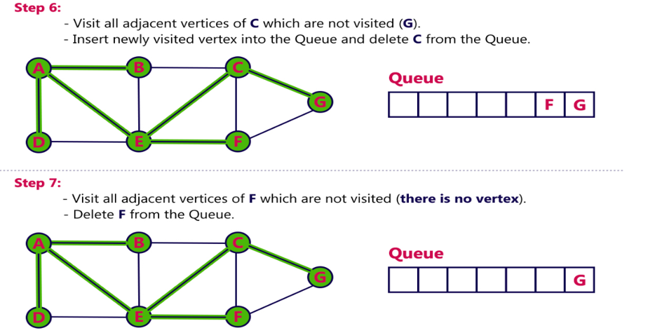
BFS

Slide 79
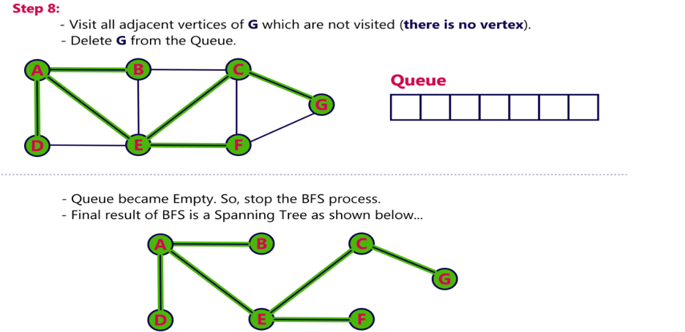
BFS

Slide 80
Time and Space for BFS
•Space complexity
•In the breadth-first search algorithm, all the nodes at a particular level must be saved until their child nodes in the next level have been generated.
•The space complexity is therefore proportional to the number of nodes at the deepest level of the graph. Given a graph with branching factor b (number of children at each node) and depth d, the asymptotic space complexity is the number of nodes at the deepest level O(bd).
•Time complexity
•In the worst case, breadth-first search has to traverse through all paths to all possible nodes, thus the time complexity of this algorithm asymptotically approaches O(bd).
•However, the time complexity can also be expressed as O( | E | + | V | ), since every vertex and every edge will be explored in the worst case.

Slide 81

How efficient is Breadth-first search?
Thus, for the adjacency matrix representation, the traversal's time is in
for the adjacency list representation, it is in
where lVI and lEI are the number of the graph's vertices and edges, respectively.
Notes:
since it takes just the time proportional to the size of the data structure used for representing the graph in question.

Slide 82
Applications of BFS
•Breadth-first search can be used to solve many problems such as:
•Finding all connected components in a graph G.
•Finding all nodes within an individual connected component.
•Finding the shortest path between two nodes, u and v, of an unweighted graph.
•Finding the shortest path between two nodes, u and v, of a weighted graph.

Slide 83
Depth First Search
Depth-First Search (DFS) starts at an arbitrary vertex and marks it as visited.
On each iteration, DFS proceeds to an unvisited vertex that is adjacent to the current vertex.
If there are multiple unvisited adjacent vertices, a tie can be resolved arbitrarily (such as alphabetical order in our examples).
The process continues until a dead end is encountered, which is a vertex with no adjacent unvisited vertices.
At a dead end, the algorithm backtracks by one edge to the vertex it came from and tries to continue visiting unvisited vertices from there.
The algorithm eventually halts after backing up to the starting vertex, with all vertices in the same connected component as the starting vertex being visited. If unvisited vertices remain, the DFS can be restarted at any one of them.

Slide 84
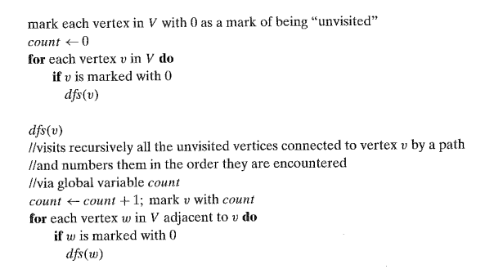
Algorithm of DFS
ALGORITHM DFS(G) //Implements a depth-first search traversal of a given graph
//Input: Graph G = (V, E)
//Output: Graph G with its vertices marked with consecutive integers
//in the order they've been first encountered by the DFS traversal

Slide 85
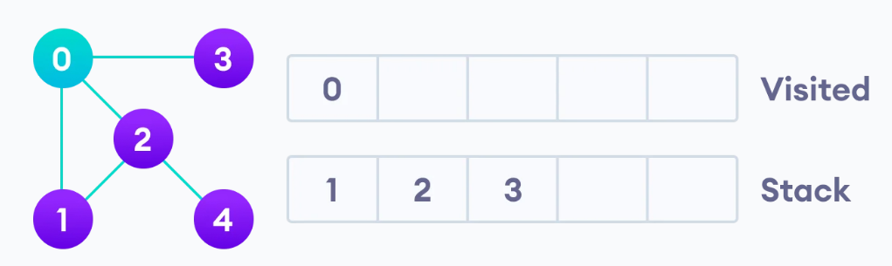
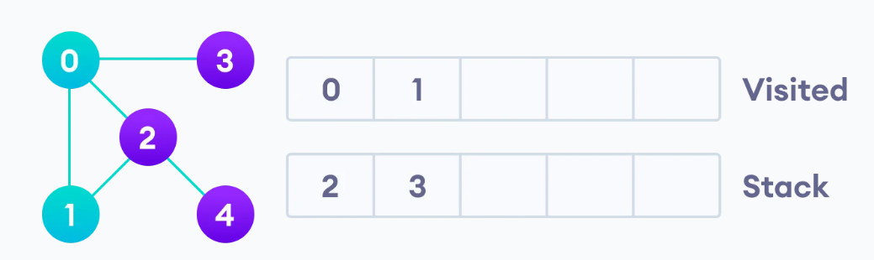
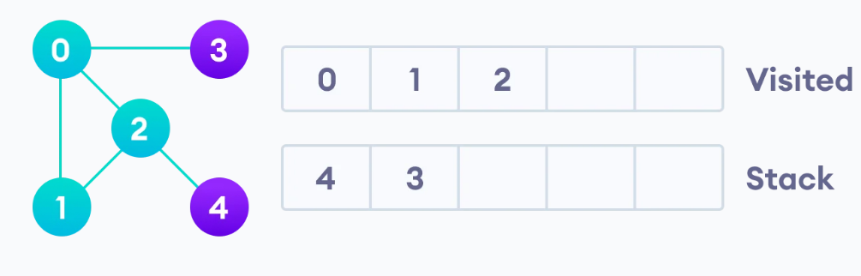
DFS

Slide 86
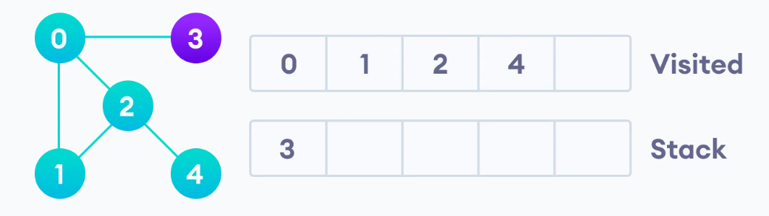
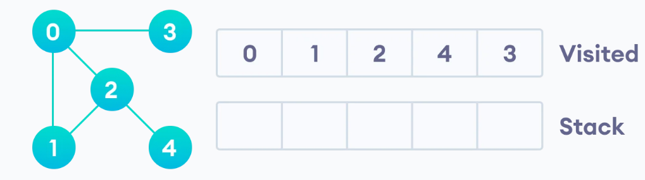
DFS

Slide 87
Time and Space Complexity
Time Complexity: The time complexity of DFS is proportional to the size of the data structure used to represent the graph. In the case of an adjacency matrix representation, the time complexity is O(V^2), where V is the number of vertices. This is because for each vertex, we need to examine all possible edges. In the case of an adjacency list representation, the time complexity is O(V + E), where V is the number of vertices and E is the number of edges. This is because we only need to consider the vertices and edges that are actually present in the graph.
Space Complexity: The space complexity of DFS depends on the maximum depth of the recursion stack, which is determined by the structure of the graph. In the worst case scenario, where the graph is a linear chain, the space complexity is O(V), where V is the number of vertices. This is because each recursive call adds a new frame to the stack. However, in general, the space complexity of DFS is considered to be O(V), where V is the number of vertices.

Slide 88
Applications of DFS
•Finding a path between two specified nodes, u and v, of an unweighted graph.
•Finding a path between two specified nodes, u and v, of a weighted graph.
•Finding whether a graph is connected or not.
•Computing the spanning tree of a connected graph.

